Slide 1
Functional Modeling using Standard-based Modeling
UML and BPMN Notation, auto-generated documentation, and implementation artifacts

Slide 2
Objectives
Discuss the use of model-based approaches to generating standards specification
Accelerating balloting and implementation artifact development
Maintain internal consistency of models
Generating reports from models using Sparx Exterprise Architect

Slide 3
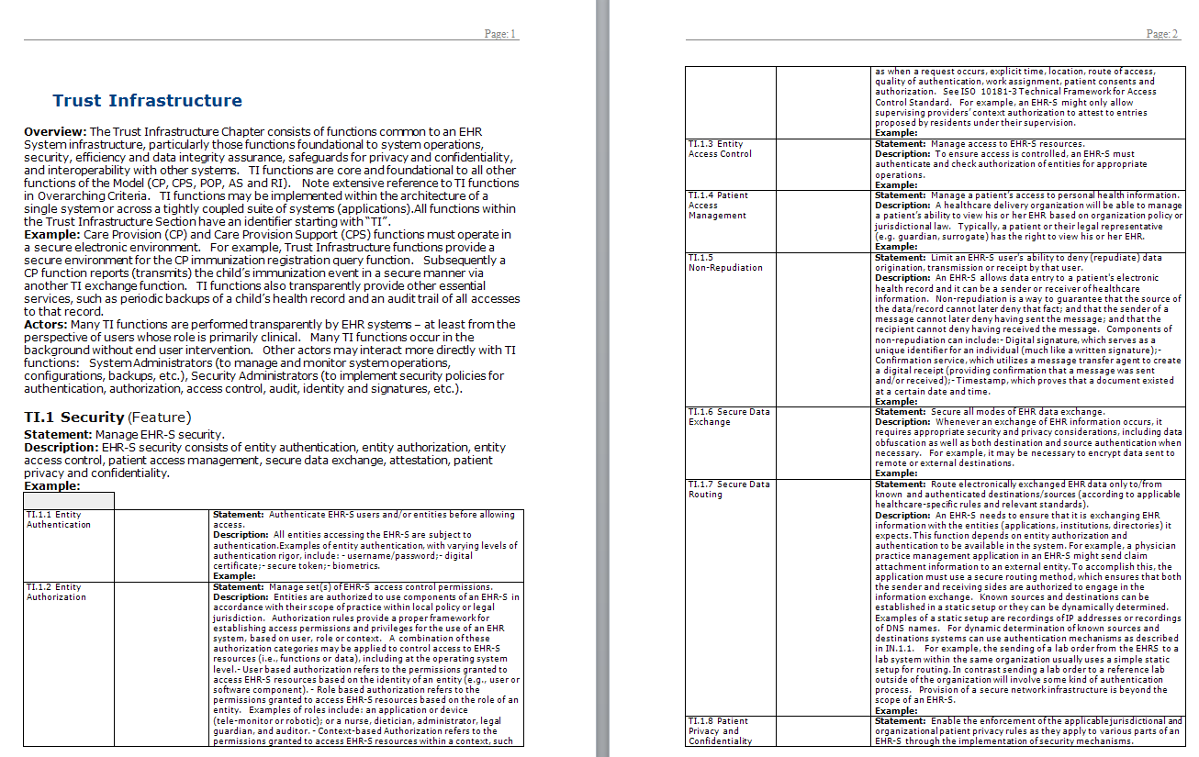
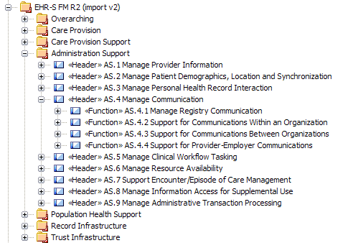
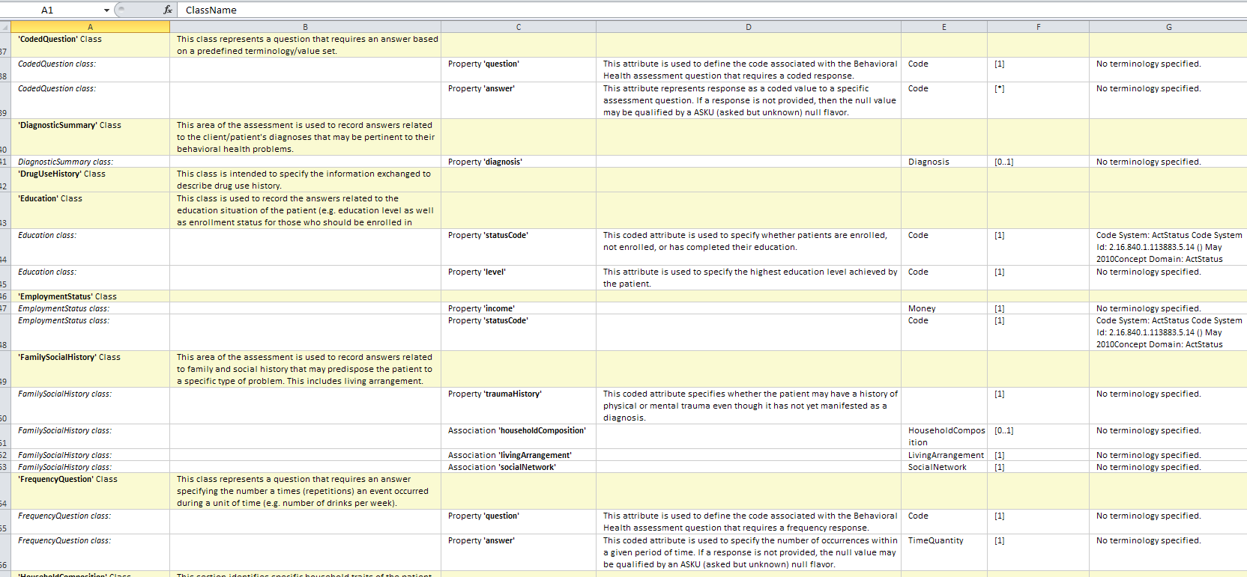
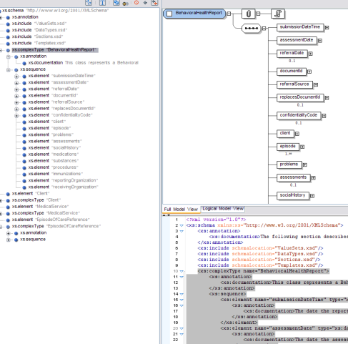
Model-Driven Approach
Test-related report
Auto-generated using scripts and templates
Functional Model
Ballot publication report
Maintained using a modeling tool
(e.g. Sparx Enterprise Architect)
Spreadsheet Report (.xlsx file)
Functional
Profile
Implementation artifact
Notes:
What would this mean for EHR Functiinal Models

Slide 4
Customized Report – Topic Based Example
May be used to specify test methods
“Rolled up” header functions have been selected for publication

Slide 5
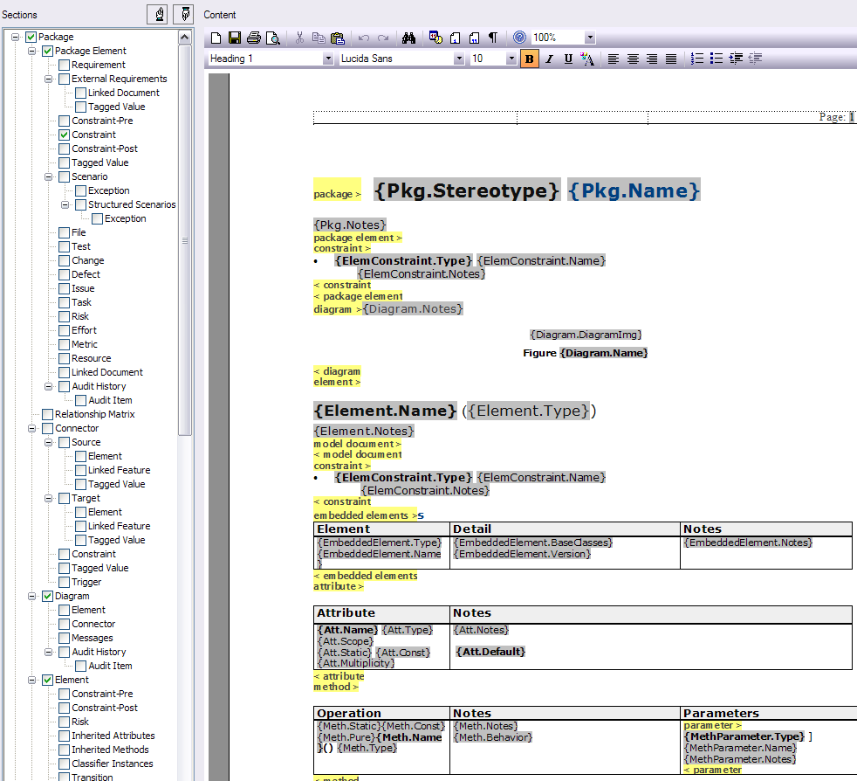
EA RTF Templates for Publication

Slide 6
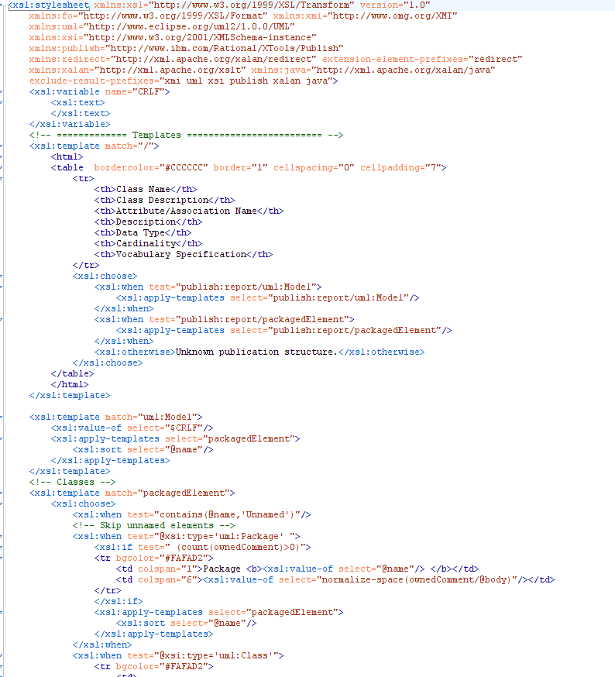
XSLT Template for Publication Generation – FOP, HTML generation
XMI → .csv
XMI → .html → .xslx
XSL transform of model content to other file formats (e.g. html, csv)

Slide 7
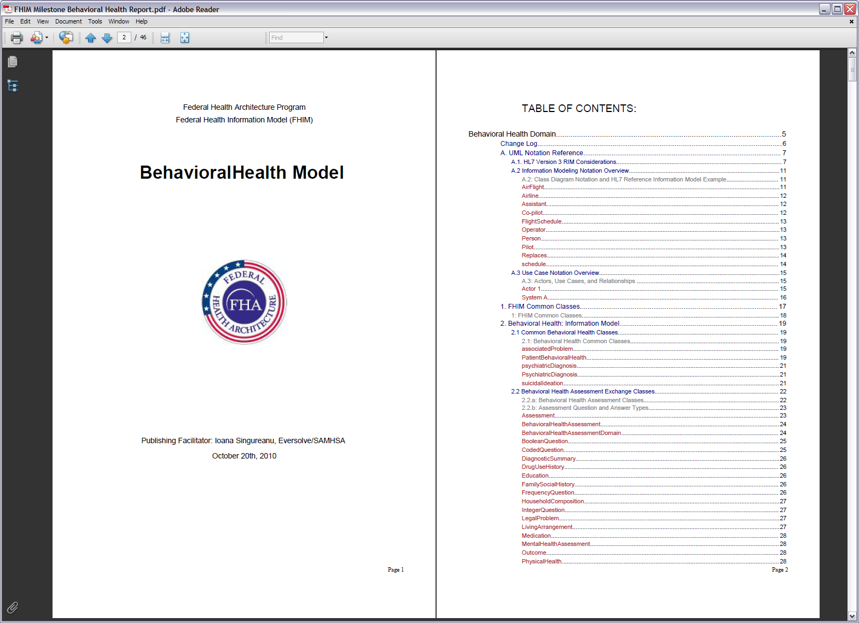
Follows the model structure

Slide 8
Spreadsheet view (information model example)
Class Details
Vocab bindings

Slide 9
Ballot Publication
Boilerplate introduction document
Auto-generated report
Auto-generated or boilerplate glossary

Slide 10
Implementation Artifacts
Auto-generated using model transformations
XSD
WSDL
Java code stubs
...

Slide 11
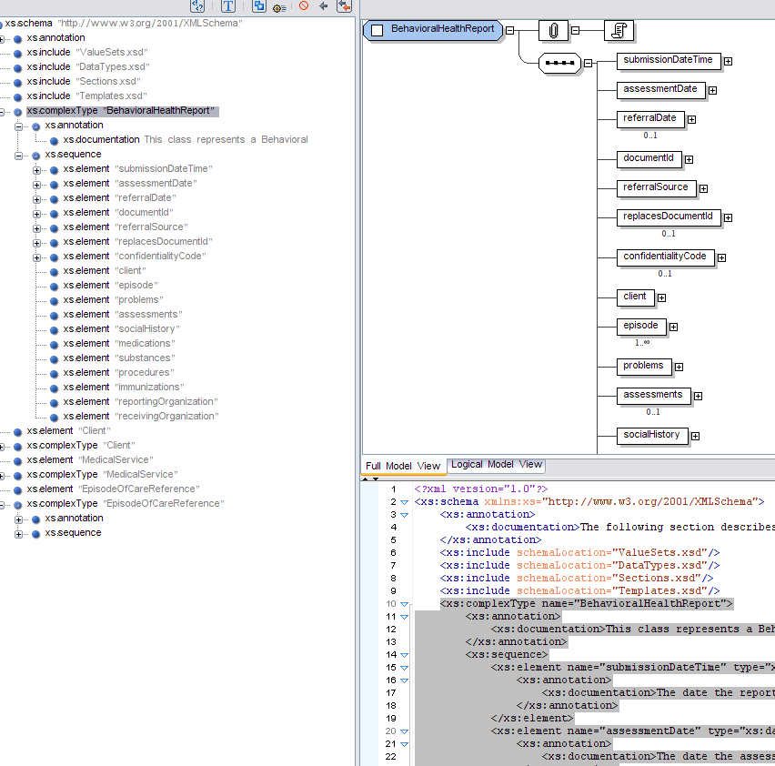
Implementation Artifacts – if needed
Generated from model transforms

Slide 12
Functional Profiles
We need a more precise methodology
Example
A package based on the EHR FM model containing
Extensions (functional conformance criteria)
Constraints (functional conformance criteria)
Information Criteria
Information structure
Semantics – value sets based on standard terminology
May constrain EHR FM criteria
Standard implementation guidance
Implementation Guides based on HL7 standards

Slide 13
Functional Elaboration
Using behavioral diagrams
Elaborates the functionality into concrete steps
Implementation neutral

Slide 14

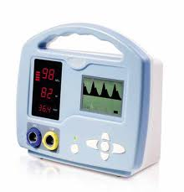

Workflow
Device may monitor continuously or episodic/spot check
If measurement fails to acquire a value, an alarm may be sent under certain circumstances
Verification at the point of care
Notes:
Under what circumstances/configuration is an alarm sent?

Slide 15
Re-attach probe

Slide 16
Verification in the info system

Slide 17
Data Analysis for Transactions
Current Standard and future technical enhancements created by this project
Standard Codes will be used to represent these concepts
Associated information
Measured Results
Notes:
Typically the typeOfSensor and bodySite (including the sole of the foot) recorded for each results are expected to match. Both data elements are used to determine whether the probe was used in the approved site.
In addition to body site we need laterality (left/right, lower/upper, index) added to the body site. Blood circulation could account for difference in measurement differences/

Slide 18
Results Information - Detail
Oxygen Saturation identifier is a code as “Coded Value”
Zero or one occurrence - Optional
Result: numeric quantity and units
Zero or more occurrences – Repeated, optional
Indicates the result is out of range
Should match the probe body site
Standard codes, units of measure

Slide 19
Standard Codes will be used to represent these concepts
Notes:
The device may not be able to supply the supplemental oxygen information. Other information - like condition/co-morbidity – is important to interpreting the information.
Supplemental O2 may be associated with spot-check. Co-morbidity may be relevant to continuous monitoring of data.
Today most devices do not provide the respiratory rate measurement automatically but in the future it may become common for pulse oximeters support it.

Slide 20
Verification of results
These data structures are reused for all identifiers, names, etc.

Slide 21

Questions

